Slide 1
Towards A Cleaner Future:
An Investigation Of Global Electricity Production
Group# 6
Xiao Shao, Mojtaba AlShams, Sarah Mutahar

Slide 2
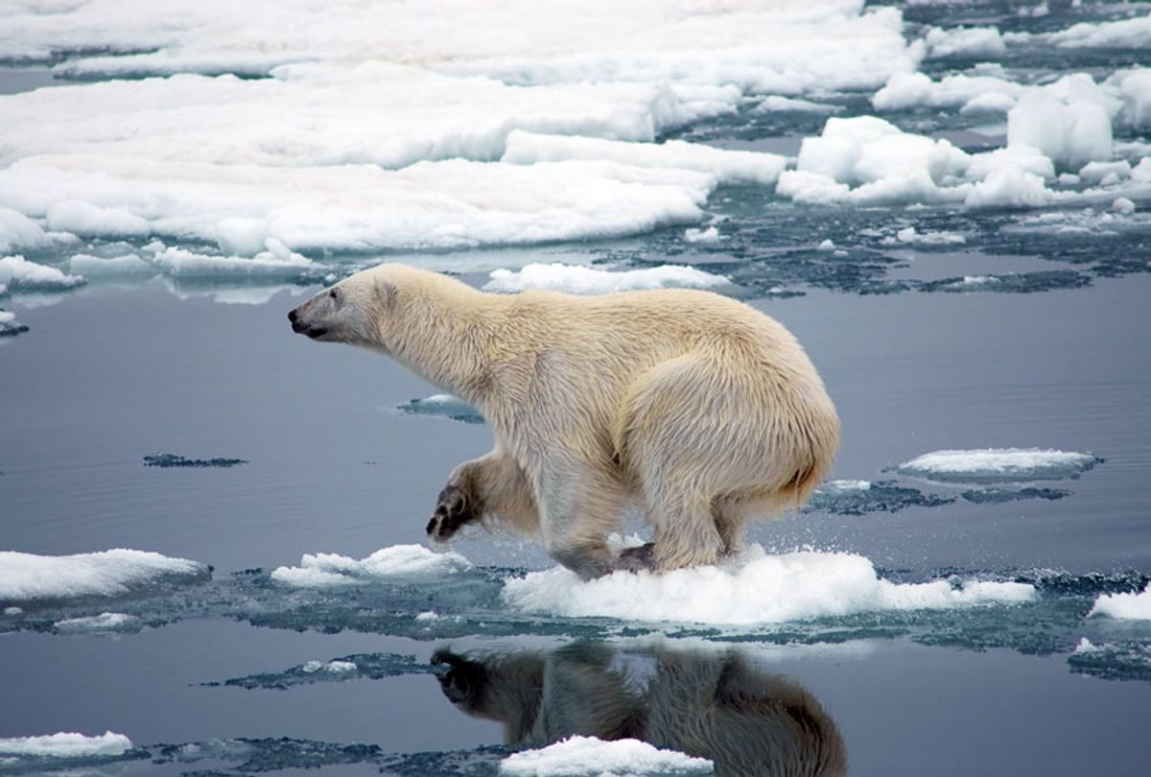

Slide 3
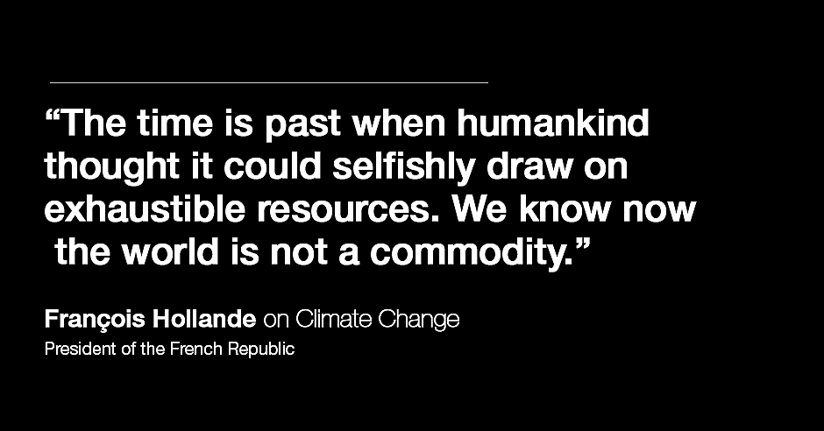
y

Slide 4
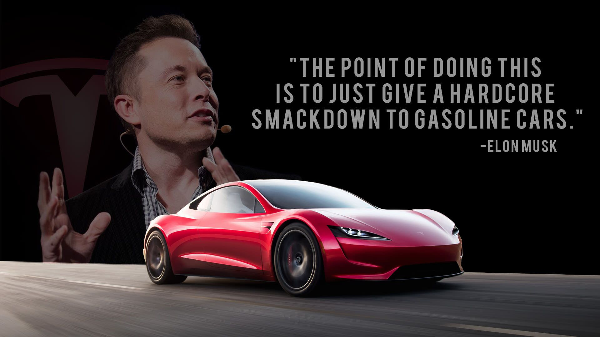
Will Eclectic Vehicles Contribute To A Sustainable Environment?

Slide 5
Terminologies

Slide 6
Terminologies
GDP per capita
(Gross domestic product)
EV
(Eclectic Vehicles)
Low-carbon electricity
(Generation Produce Low-Carbon Emissions)
High-carbon electricity
(Generation Produce High-Carbon Emissions)

Slide 7
Electricity access and GDP per capita

Slide 8
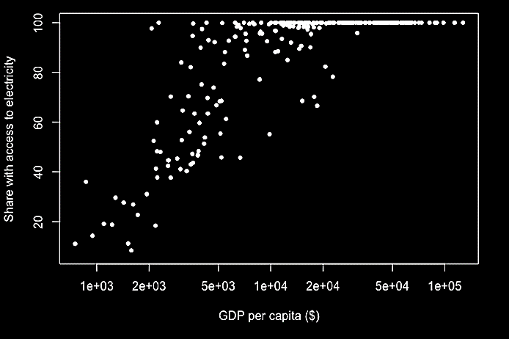
Electricity access and GDP per capita

Slide 9
Electricity access and GDP per capita
Linear behavior

Slide 10
Electricity access and GDP per capita
Saturation
Linear behavior

Slide 11
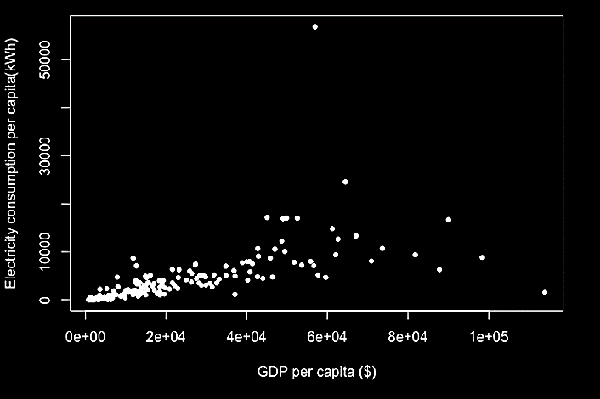
Electricity consumption and GDP per capita

Slide 12
Electricity consumption and GDP per capita
Linear behavior

Slide 13
Electricity consumption and GDP per capita
Iceland
Luxembourg
Linear behavior

Slide 14
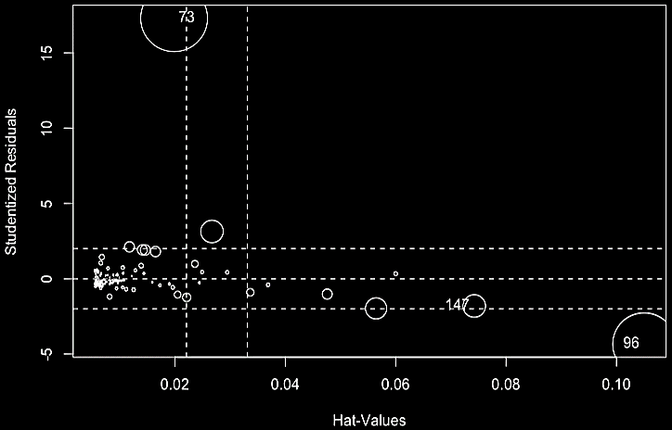
Electricity consumption and GDP per capita
Iceland
Luxembourg

Slide 15
Electricity consumption and GDP per capita
Iceland
Luxembourg

Slide 16
Linear Regression Model
Iceland
Including the outliers
Luxembourg

Slide 17
Linear Regression Model
Iceland
Excluding
Iceland
Including the outliers
Luxembourg

Slide 18
Linear Regression Model
Iceland
Excluding
Iceland
Including the outliers
Luxembourg
Excluding
Luxembourg

Slide 19
Linear Regression Model
Iceland
Excluding
Iceland
Including the outliers
Excluding all outliers
Luxembourg
Excluding
Luxembourg

Slide 20
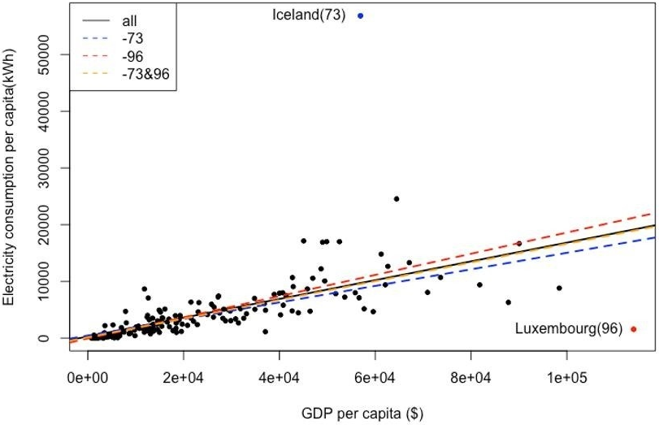
Electricity consumption and GDP per capita

Slide 21
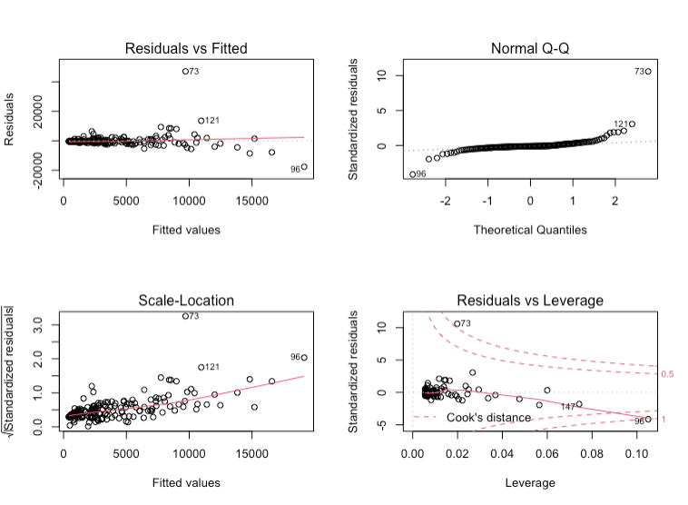
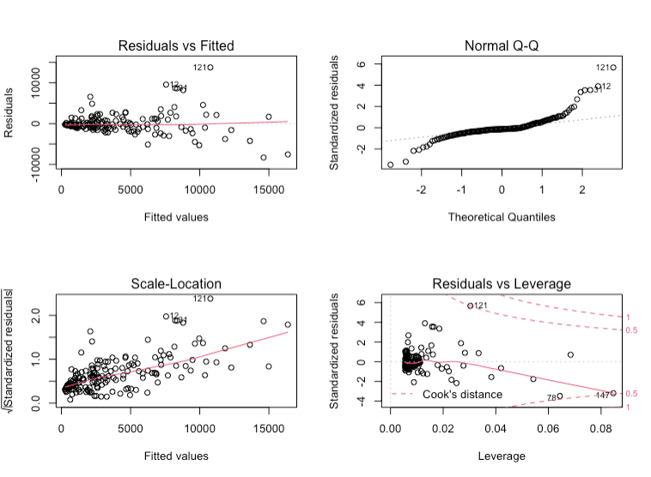
Diagnostic Plots
Including the Outliers
Excluding All Outliers

Slide 22
The Final Model

Slide 23
The Final Model
The final model including all the points:
𝐸𝑙𝑒𝑐𝑡𝑟𝑖𝑐𝑖𝑡𝑦_𝑐𝑜𝑛𝑠𝑢𝑚𝑝𝑡𝑖𝑜𝑛_𝑝𝑒𝑟_𝑐𝑎𝑝𝑖𝑡𝑎 = 285.8 + 0.165 × 𝐺𝐷𝑃_𝑝𝑒𝑟_𝑐𝑎𝑝𝑖𝑡a
The final model excluding all the outliers:
𝐸𝑙𝑒𝑐𝑡𝑟𝑖𝑐𝑖𝑡𝑦_𝑐𝑜𝑛𝑠𝑢𝑚𝑝𝑡𝑖𝑜𝑛_𝑝𝑒𝑟_𝑐𝑎𝑝𝑖𝑡𝑎 = 134.1 + 0.165 × 𝐺𝐷𝑃_𝑝𝑒𝑟_𝑐𝑎𝑝𝑖𝑡a

Slide 24
Electricity Consumption From Low-carbon Source And GDP Per Capita

Slide 25

Electricity Consumption From Low-carbon Source And GDP Per Capita
Definitions:
High-Carbon Electricity: Generated using high-carbon resources.
Low-Carbon Electricity: Generated using Low-carbon resources.
$r_{low}$
$$EC_{low} is \text{electrical} \text{consumption} \text{using} \text{low} \text{carbon} \text{resources}$$
$$EC_{high} is \text{electrical} \text{consumption} \text{using} \text{high} \text{carbon} \text{resources}$$

Slide 26
Electricity Consumption From Low-carbon Source And GDP Per Capita
Definitions:
$$EC_{low} is \text{electrical} \text{consumption} \text{using} \text{low} \text{carbon} \text{resources}$$
$$EC_{high} is \text{electrical} \text{consumption} \text{using} \text{high} \text{carbon} \text{resources}$$
Countries had been classified into five categories using GPD/Capita:
lower-income
low-income
mid-income
high-income
higher-income

Slide 27
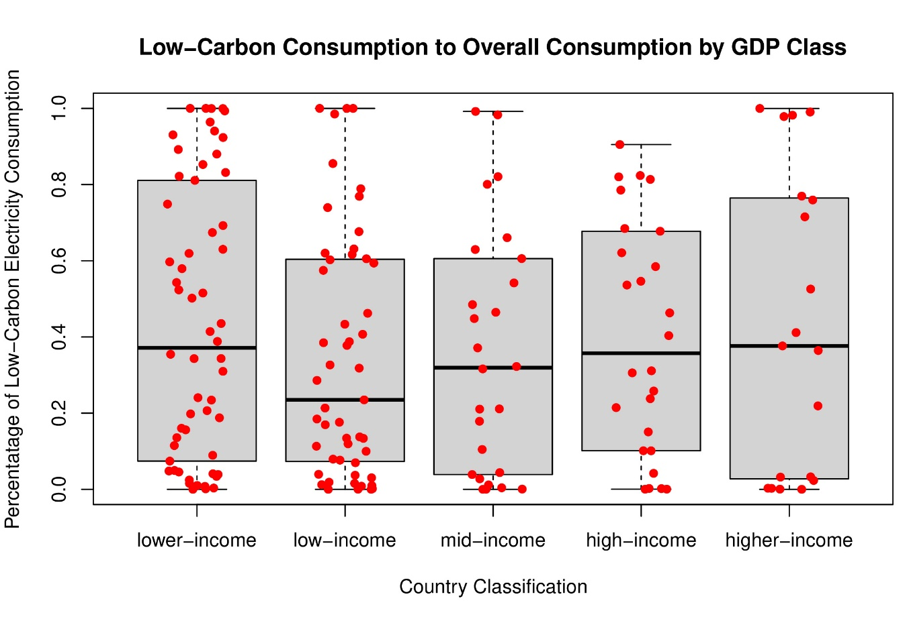

Electricity Consumption From Low-carbon Source And GDP Per Capita
The study aims to find whether $r_{low}$ is different for different countries categories.
ANOVA!

Slide 28

Electricity Consumption From Low-carbon Source And GDP Per Capita
ANOVA
$$p=0.652$$
Fail to Reject the Null Hypothesis!

Slide 29

Electricity Consumption From Low-carbon Source And GDP Per Capita
ANOVA, Conclusion!
$$p=0.652$$
Regardless of how rich the country is,
ALL CLASSES HAVE THE SAME LOW-CARBON CONSUMPTION RATIO!

Slide 30
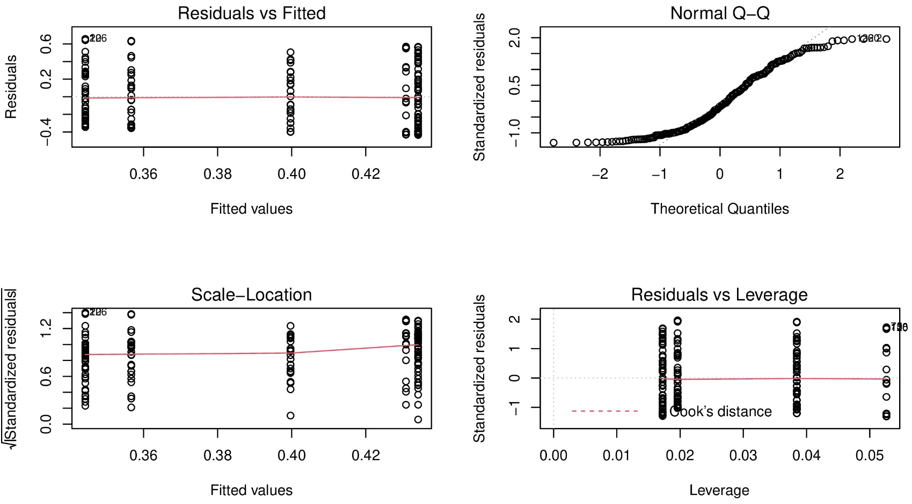
Electricity Consumption From Low-carbon Source And GDP Per Capita
ANOVA, Diagnostic Plots:

Slide 31
Statistical Analysis Summary

Slide 32
Statistical Analysis Summary
Linear correlation between electrical consumption and GDP:
𝐸𝑙𝑒𝑐𝑡𝑟𝑖𝑐𝑖𝑡𝑦_𝑐𝑜𝑛𝑠𝑢𝑚𝑝𝑡𝑖𝑜𝑛_𝑝𝑒𝑟_𝑐𝑎𝑝𝑖𝑡𝑎 = 134.1 + 0.165 × 𝐺𝐷𝑃_𝑝𝑒𝑟_𝑐𝑎𝑝𝑖𝑡a
All countries have similar low-carbon electricity consumption share.

Slide 33
Will Eclectic Vehicles Contribute
To A Sustainable Environment?

Slide 34



Thank you for listening!
Group# 6 is glad to answer your questions!
References:
Elon Musk quote Francois Hollande quote Dataset Used

